Slide 1

Binary Optimization Project
Submitted by: Itay Snir & Yonatan Maman
Lecturer: Dr. Gadi Haber

Slide 2

Main ideas
Find the 5 hottest loops candidates
Loops with the maximum number instruction multiply total number iterations
Loop unrolling of this loops

Slide 3
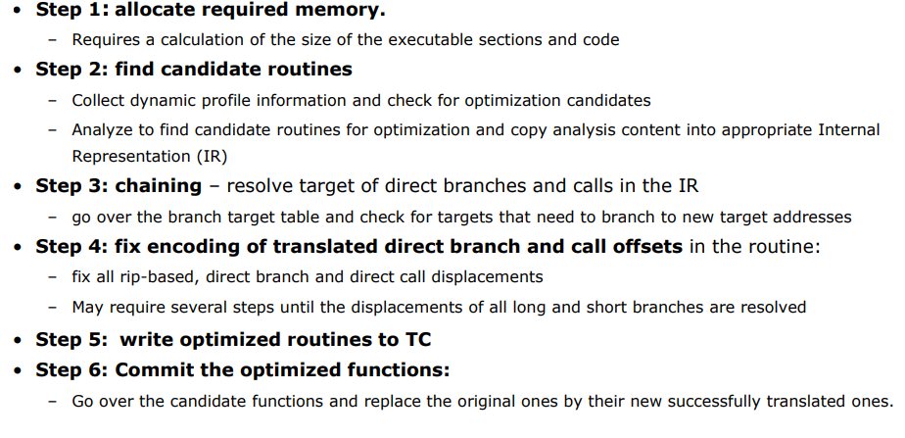
Loop Unrolling implementation

Slide 4
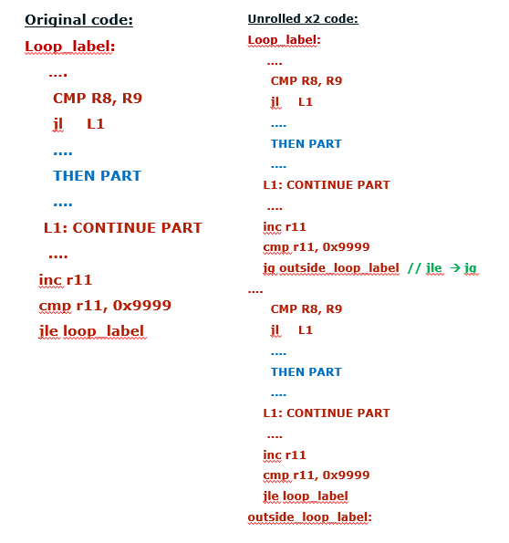
Examples of loop unrolling

Slide 5
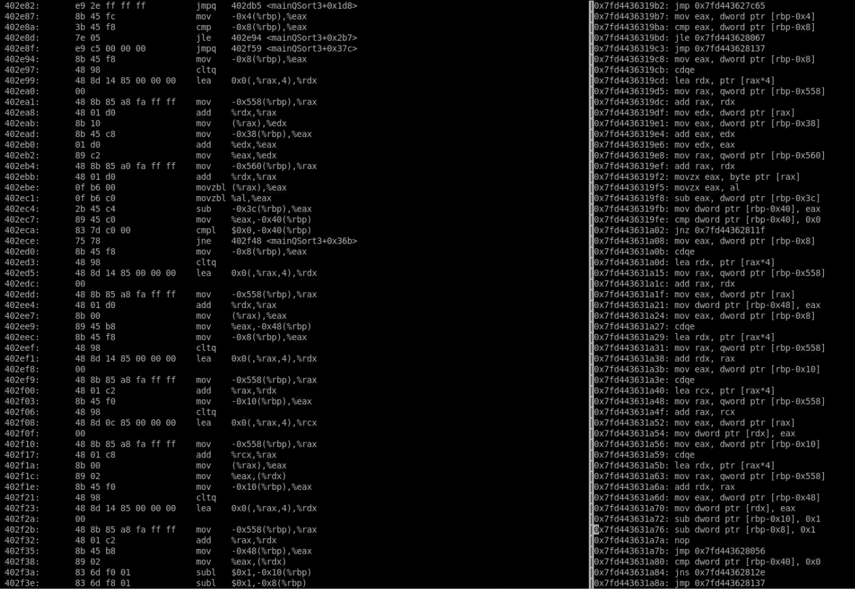
Start loop
First loop unrolling
Original code
Dumping
TC

Slide 6
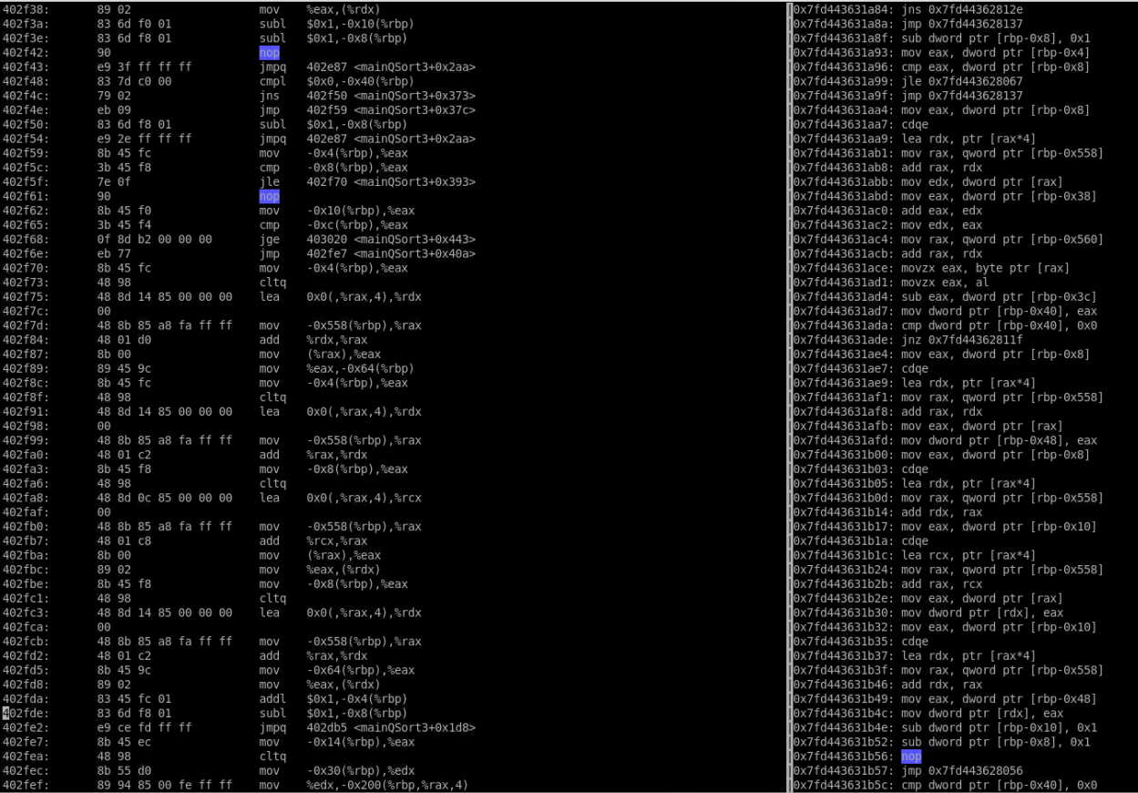
End loop
second loop unrolling
End loop

Slide 7
results

